Slide 1
Chapter 2: Properties of Fluids
Chao-Lung Ting
Department of Engineering Science and Ocean Engineering
National Taiwan University
Fall 2014

Slide 2
Introduction
Any characteristic of a system is called a property.
  Familiar: pressure P, temperature T, volume V, and mass m.
  Less familiar: viscosity, thermal conductivity, modulus of elasticity, thermal expansion coefficient, vapor pressure, surface tension.
Intensive properties are independent of the mass of the system. Examples: temperature, pressure, and density.
Extensive properties are those whose value depends on the size of the system. Examples: Total mass, total volume, and total momentum.
Extensive properties per unit mass are called specific properties. Examples include specific volume v = V/m and specific total energy e=E/m.

Slide 3
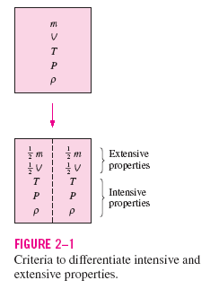
Introduction
Intensive properties and
Extensive properties

Slide 4
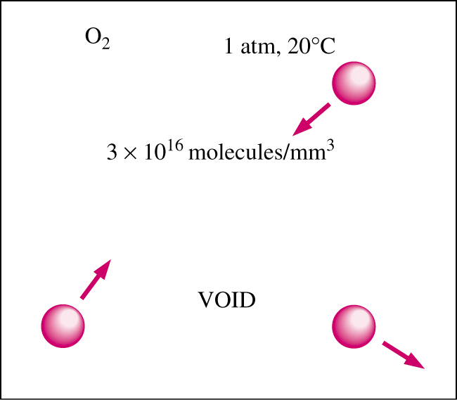
Continuum
Atoms are widely spaced in the gas phase.
However, we can disregard the atomic nature of a substance.
View it as a continuous, homogeneous matter with no holes, that is, a continuum.
This allows us to treat properties as smoothly varying quantities.
Continuum is valid as long as size of the system is large in comparison to distance between molecules.
In this text we limit our consideration to substances that can be modeled as a continuum.
D of O₂ molecule = 3x10⁻¹⁰ m
mass of O₂ = 5.3x10⁻²⁶ kg
Mean free path = 6.3x10⁻⁸ m
at 1 atm pressure and 20°C

Slide 5
Density and Specific Gravity
Density is defined as the mass per unit volume ρ = m/V. Density has units of kg/m³
Specific volume is defined as v = 1/ρ = V/m.
For a gas, density depends on temperature and pressure.
Specific gravity, or relative density is defined as the ratio of the density of a substance to the density of some standard substance at a specified temperature (usually water at 4°C), i.e., SG=ρ/ρ_{H20}. SG is a dimensionless quantity.
The specific weight is defined as the weight per unit volume, i.e., γ_{s} = ρg where g is the gravitational acceleration. γ_{s} has units of N/m³.

Slide 6
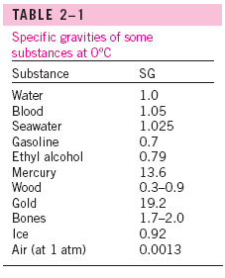
Density and Specific Gravity

Slide 7
Density of Ideal Gases
Equation of State: equation for the relationship between pressure, temperature, and density.
The simplest and best-known equation of state is the ideal-gas equation.
P v = R T or P = ρ R T
where P is the absolute pressure, v is the specific volume, T is the thermodynamic (absolute) temperature, ρ is the density, and R is the gas constant.

Slide 8
Density of Ideal Gases
The gas constant R is different for each gas and is determined from R = R_{u} /M,
where R_{u} is the universal gas constant whose value is R_{u} = 8.314 kJ/kmol · K = 1.986 Btu/lbmol · R, and M is the molar mass (also called molecular weight) of the gas. The values of R and M for several substances are given in Table A–1.

Slide 9

Density of Ideal Gases
The thermodynamic temperature scale
  In the SI is the Kelvin scale, designated by K.
  In the English system, it is the Rankine scale, and the temperature unit on this scale is the rankine, R. Various temperature scales are related to each other by
(2–5)
(2–6)
It is common practice to round the constants 273.15 and 459.67 to 273 and 460, respectively.

Slide 10
Density of Ideal Gases
For an ideal gas of volume V, mass m, and number of moles N = m/M, the ideal-gas equation of state can also be written as
PV = mRT or PV = NR_{u}T.
For a fixed mass m, writing the ideal-gas relation twice and simplifying, the properties of an ideal gas at two different states are related to each other by
P₁V₁/T₁ = P₂V₂/T₂.

Slide 11
Density of Ideal Gases
An ideal gas is a hypothetical substance that obeys the relation Pv = RT.
Ideal-gas equation holds for most gases.
However, dense gases such as water vapor and refrigerant vapor should not be treated as ideal gases. Tables should be consulted for their properties, e.g., Tables A-3E through A-6E in textbook.

Slide 12
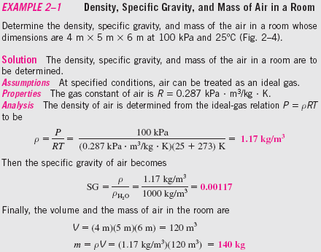
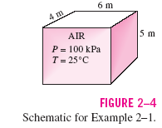
Density of Ideal Gases

Slide 13
Vapor Pressure and Cavitation
Pressure – temperature relation at (liquid – solid) phase change
At a given pressure, the temperature at which a pure substance changes phase is called the saturation temperature T_{sat}.
Likewise, at a given temperature, the pressure at which a pure substance changes phase is called the saturation pressure P_{sat}.
At an absolute pressure of 1 standard atmosphere (1 atm or 101.325 kPa), for example, the saturation temperature of water is 100°C. Conversely, at a temperature of 100°C, the saturation pressure of water is 1 atm.

Slide 14
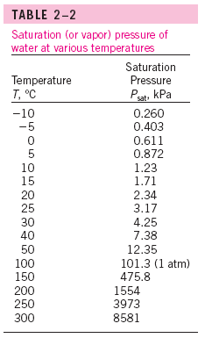
Vapor Pressure and Cavitation
Water boils at 134°C in a pressure cooker operating at 3 atm absolute pressure, but it boils at 93°C in an ordinary pan at a 2000-m elevation, where the atmospheric pressure is 0.8 atm. The saturation (or vapor) pressures are given in Appendices 1 and 2 for various substances.

Slide 15
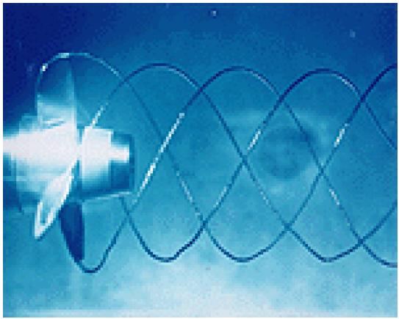
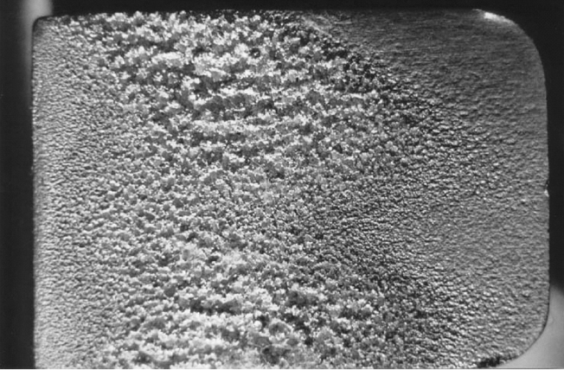
Vapor Pressure and Cavitation
Vapor Pressure P_{v} is defined as the pressure exerted by its vapor in phase equilibrium with its liquid at a given temperature
Partial pressure is defined as the pressure of a gas or vapor in a mixture with other gases.
If P drops below P_{v}, liquid is locally vaporized, creating cavities of vapor.
Vapor cavities collapse when local P rises above P_{v}.
Collapse of cavities is a violent process which can damage machinery.
Cavitation is noisy, and can cause structural vibrations.

Slide 16
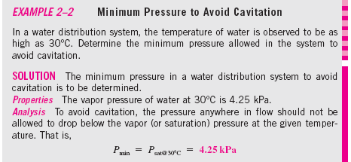

Vapor Pressure and Cavitation

Slide 17
Energy and Specific Heats
Total energy E (or e on a unit mass basis) is comprised of numerous forms:
thermal,
mechanical,
kinetic,
potential,
electrical,
magnetic,
chemical,
and nuclear.
Units of energy are joule (J) or British thermal unit (BTU).

Slide 18
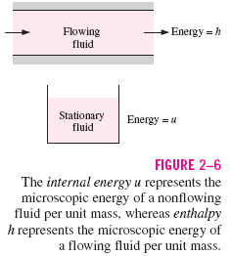
Energy and Specific Heats
Microscopic energy
Internal energy U (or u on a unit mass basis) is for a non-flowing fluid and is due to molecular activity.
Enthalpy h=u+Pv is for a flowing fluid and includes flow energy (Pv).
where Pv is the flow energy, also called the flow work, which is the energy per unit mass needed to move the fluid and maintain flow.
Note that enthalpy is a quantity per unit mass, and thus it is a specific property.

Slide 19
Energy and Specific Heats
Macroscopic energy
  Kinetic energy ke=V²/2
  Potential energy pe=gz
In the absence of magnetic, electric, and surface tension, a system is called a simple compressible system. The total energy of a simple compressible system consists of internal, kinetic, and potential energies.
On a unit-mass basis, it is expressed as e =u + ke + pe. The fluid entering or leaving a control volume possesses an additional form of energy—the flow energy P/ρ. Then the total energy of a flowing fluid on a unit-mass basis becomes
e_{flowing}= P/ρ + e =h + ke + pe = h +V²/2+gz.

Slide 20
Energy and Specific Heats
By using the enthalpy instead of the internal energy to represent the energy of a flowing fluid, one does not need to be concerned about the flow work. The energy associated with pushing the fluid is automatically taken care of by enthalpy. In fact, this is the main reason for defining the property enthalpy.
The changes of internal energy and enthalpy of an ideal gas are expressed as
du=c_{v}dT and dh=c_{p}dT
where c_{v} and c_{p} are the constant-volume and constant-pressure specific heats of the ideal gas.
For incompressible substances, c_{v} and c_{p} are identical.

Slide 21
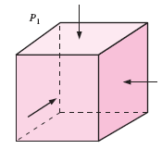
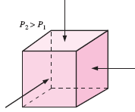
Coefficient of Compressibility
How does fluid volume change with P and T?
Fluids expand as T ↑ or P ↓
Fluids contract as T ↓ or P ↑

Slide 22
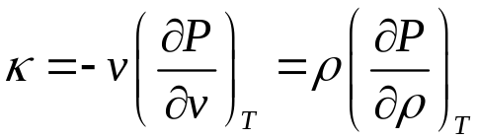
Coefficient of Compressibility
Need fluid properties that relate volume changes to changes in P and T.
  Coefficient of compressibility
  κ must have the dimension of pressure (Pa or psi).
  What is the coefficient of compressibility of a truly incompressible substance ?(v=constant).
(or bulk modulus of compressibility or bulk modulus of elasticity)
is infinity

Slide 23
Coefficient of Compressibility
A large κ implies incompressible.
This is typical for liquids considered to be incompressible.
For example, the pressure of water at normal atmospheric conditions must be raised to 210 atm to compress it 1 percent, corresponding to a coefficient of compressibility value of κ = 21,000 atm.

Slide 24
Coefficient of Compressibility
Small density changes in liquids can still cause interesting phenomena in piping systems such as the water hammer—characterized by a sound that resembles the sound produced when a pipe is “hammered.” This occurs when a liquid in a piping network encounters an abrupt flow restriction (such as a closing valve) and is locally compressed. The acoustic waves produced strike the pipe surfaces, bends, and valves as they propagate and reflect along the pipe, causing the pipe to vibrate and produce the familiar sound.

Slide 25

Coefficient of Compressibility
Differentiating ρ = 1/v gives dρ = - dv/v²; therefore, dρ/ρ = - dv/v
For an ideal gas, P = ρRT and (∂P/∂ρ)_{T} = RT = P/ρ, and thus
κ_{ideal gas} = P (Pa)
The inverse of the coefficient of compressibility is called the isothermal compressibility α and is expressed as

Slide 26
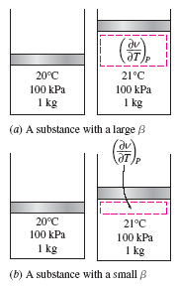
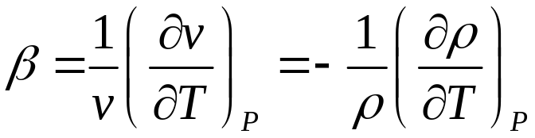
Coefficient of Volume Expansion
The density of a fluid depends more strongly on temperature than it does on pressure.
To represent the variation of the density of a fluid with temperature at constant pressure. The Coefficient of volume expansion (or volume expansivity) is defined as
(1/K)

Slide 27

Coefficient of Volume Expansion
For an ideal gas, β_{ideal gas} = 1/T (1/K)
In the study of natural convection currents, the condition of the main fluid body that surrounds the finite hot or cold regions is indicated by the subscript “infinity” to serve as a reminder that this is the value at a distance where the presence of the hot or cold region is not felt. In such cases, the volume expansion coefficient can be expressed approximately as
where ρ∞ is the density and T∞ is the temperature of the quiescent fluid away from the confined hot or cold fluid pocket.

Slide 28
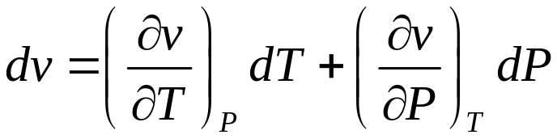
Coefficient of Compressibility
The combined effects of pressure and temperature changes on the volume change of a fluid can be determined by taking the specific volume to be a function of T and P. Differentiating v = v(T, P) and using the definitions of the compression and expansion coefficients α and β give
= (βdT - αdP)v

Slide 29
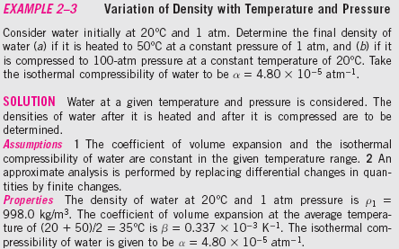
Coefficient of Compressibility

Slide 30
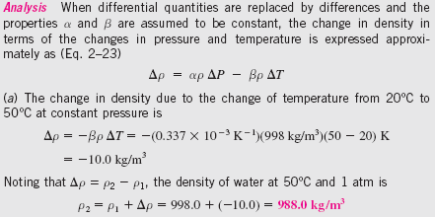
Coefficient of Compressibility

Slide 31
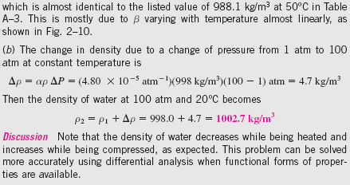
Coefficient of Compressibility

Slide 32
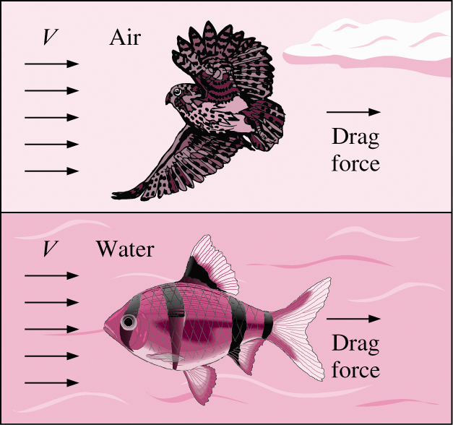
Viscosity
Viscosity is a property that represents the internal resistance of a fluid to motion.
The force a flowing fluid exerts on a body in the flow direction is called the drag force, and the magnitude of this force depends, in part, on viscosity.

Slide 33
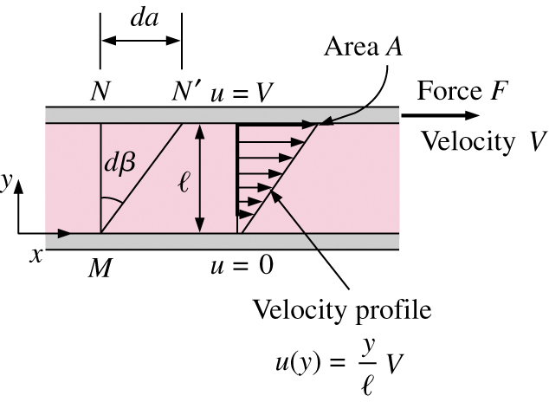
Viscosity
To obtain a relation for viscosity, consider a fluid layer between two very large parallel plates separated by a distance ℓ
Definition of shear stress is τ = F/A.
Using the no-slip condition,
u(0) = 0 and u(ℓ) = V, the velocity profile and gradient are u(y)= Vy/ℓ and du/dy=V/ℓ

Slide 34
Viscosity
dβ ≅ tan dβ = da/ ℓ = Vdt/ℓ = (du/dy)dt
Rearranging
du/dy= dβ/dt ⇒ τ ∝ dβ/dt or τ ∝ du/dy
Fluids for which the rate of deformation is proportional to the shear stress are called Newtonian fluids, such as water, air, gasoline, and oils. Blood and liquid plastics are examples of non-Newtonian fluids.
In one-dimensional flow, shear stress for Newtonian fluid:
τ = μdu/dy
μ is the dynamic viscosity and has units of kg/m·s, Pa·s, or poise.
kinematic viscosity ν = μ/ρ. Two units of kinematic viscosity are m²/s and stoke.
1 stoke = 1 cm²/s = 0.0001 m²/s

Slide 35
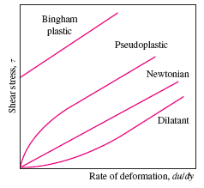
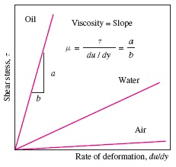
Viscosity
Non-Newtonian vs. Newtonian Fluid

Slide 36
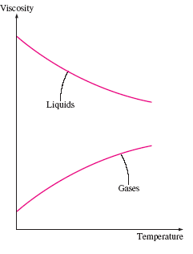

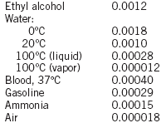
Viscosity
Gas vs. Liquid

Slide 37
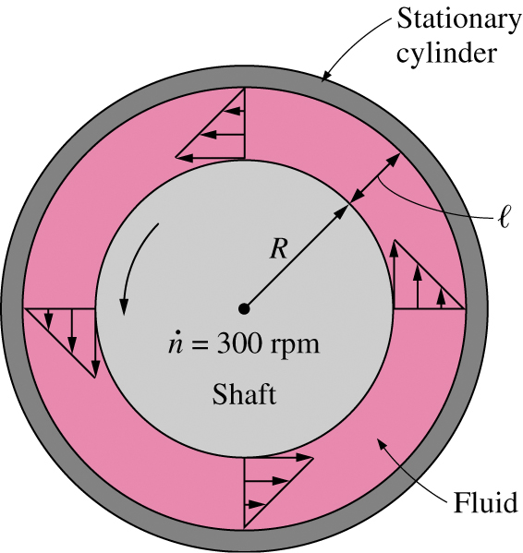
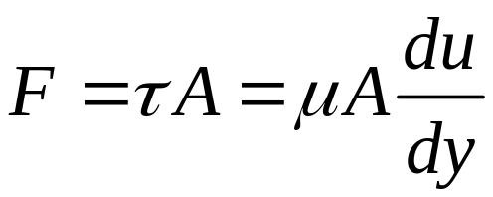

Viscometry
How is viscosity measured? A rotating viscometer.
  Two concentric cylinders with a fluid in the small gap ℓ.
  Inner cylinder is rotating, outer one is fixed.
Use definition of shear force:
If ℓ/R << 1, then cylinders can be modeled as flat plates.
Torque T = FR, and tangential velocity V=ωR
Wetted surface area A=2πRL.
Measure T and ω to compute μ

Slide 38
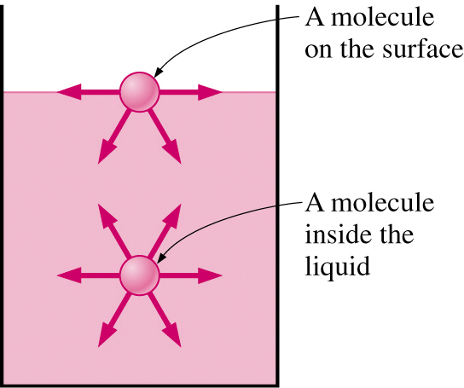
Surface Tension
Liquid droplets behave like small spherical balloons filled with liquid, and the surface of the liquid acts like a stretched elastic membrane under tension.
The pulling force that causes this is
  due to the attractive forces between molecules
  called surface tension σ_{s}.
Attractive force on surface molecule is not symmetric.
Repulsive forces from interior molecules causes the liquid to minimize its surface area and attain a spherical shape.

Slide 39
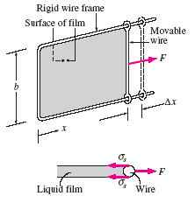
Surface Tension
σ_{s} = F/2b
The change of
surface energy =
W = Force × Distance
=F ∆x =2b σ_{s} ∆x
=σ_{s} ∆A

Slide 40
Surface Tension
The surface tension of a substance can be changed considerably by impurities, called surfactants. For example, soaps and detergents
lower the surface tension of water and enable it to penetrate through the small openings between fibers for more effective washing.

Slide 41
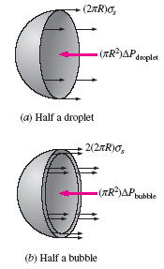
Surface Tension
Droplet: (2πR)σ_{s} = (πR²)∆P_{droplet}
→∆ P_{droplet} = P_{i} - P_{o} = 2σ_{s}/R
Bubble: 2(2πR)σ_{s} = (πR²)∆P_{droplet}
→∆ P_{droplet} = P_{i} - P_{o} = 4σ_{s}/R
where P_{i} and P_{o} are the pressures inside and outside the droplet or bubble, respectively. When the droplet or bubble is in the atmosphere, P_{o} is simply atmospheric pressure. The factor 2 in the force balance for the bubble is due to the bubble consisting of a film with two surfaces (inner and outer surfaces) and thus two circumferences in the cross section.

Slide 42
Surface Tension
The pressure difference of a droplet due to surface tension
dW_{surface} = σ_{s} dA = σ_{s} d(4πR ²) = 8πRσ_{s} dR
dW_{expansion} = Force × Distance =F dR
= (∆PA) dR = 4πR² ∆P dR
dW_{surface} = dW_{expansion}
Therefore, ∆P_{droplet} = 2σ_{s} /R,

Slide 43


Capillary Effect
Capillary effect is the rise or fall of a liquid in a small-diameter tube.
The curved free surface in the tube is call the meniscus.
Contact (or wetting) angle φ, defined as the angle that the tangent to the liquid surface makes with the solid surface at the point of contact.
Water meniscus curves up because water is a wetting (φ < 90°) fluid (hydrophilic).
Mercury meniscus curves down because mercury is a nonwetting (φ > 90°) fluid (hydrophobic).

Slide 44
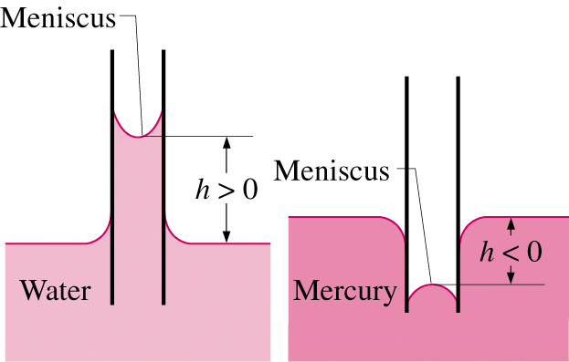
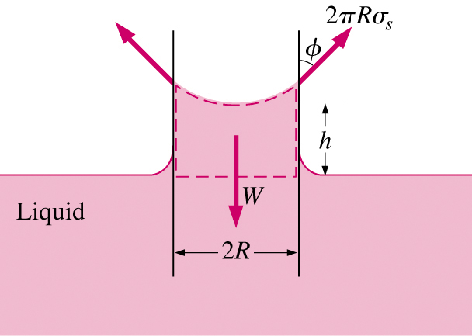
Capillary Effect
Force balance can describe magnitude of capillary rise.
W = mg = ρVg = ρg(πR²h)
W = F_{surface}
→ ρg(πR²h) = 2πRσ_{s} cos φ
Capillary rise:
→ h = 2σ_{s} cos φ / ρgR
(R = constant)

Slide 45
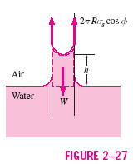
Capillary Effect
EXAMPLE 2–5 The Capillary Rise of Water in a Tube
A 0.6-mm-diameter glass tube is inserted into water at 20°C in a cup. Determine the capillary rise of water in the tube (Fig. 2–27).
Properties The surface tension of water at 20°C is 0.073 N/m (Table 2–3). The contact angle of water with glass is 0° (from preceding text). We take the density of liquid water to be 1000 kg/m³.
Capillary rise:
→ h = 2σ_{s} cos φ / ρgR=0.050 m = 5.0 cm
Note that if the tube diameter were 1 cm, the capillary rise would be 3 mm. Actually, the capillary rise in a large-diameter tube occurs only at the rim. Therefore, the capillary effect can be ignored for large-diameter tubes.

